Slide 1

Progress Presentation 1
GuardFile
Presented by
Dylan Miller
Mina Astafanous
Avyakt Rout
Bethany Bui
GuardFile
Progress Report 1
2026

Slide 2

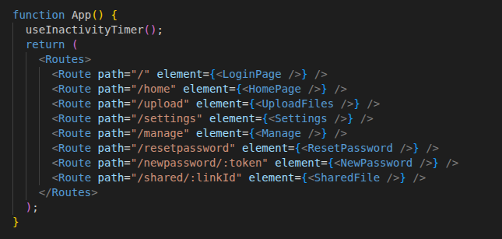
Routes: App.jsx
Home
UploadFiles
ManageFiles
Settings
ResetPassword
NewPassword
SharedFile
GuardFile
Progress Report 1

Slide 3
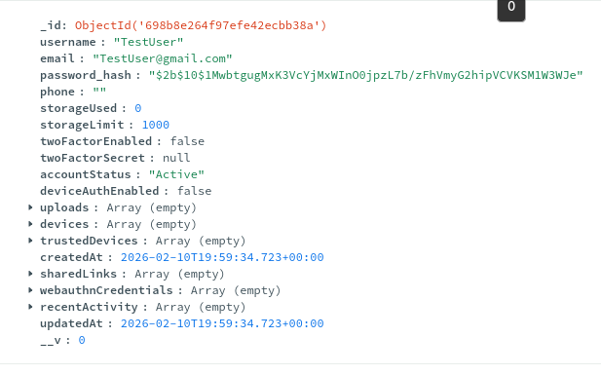
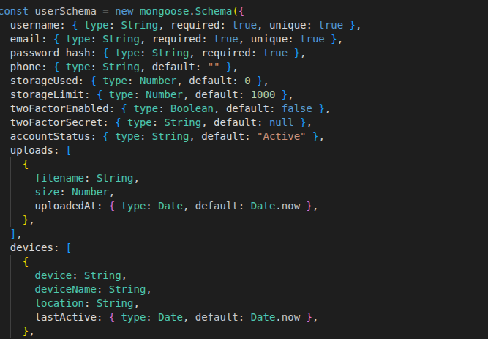
User Schema
MongoDB
Users.js
GuardFile
Progress Report 1

Slide 4
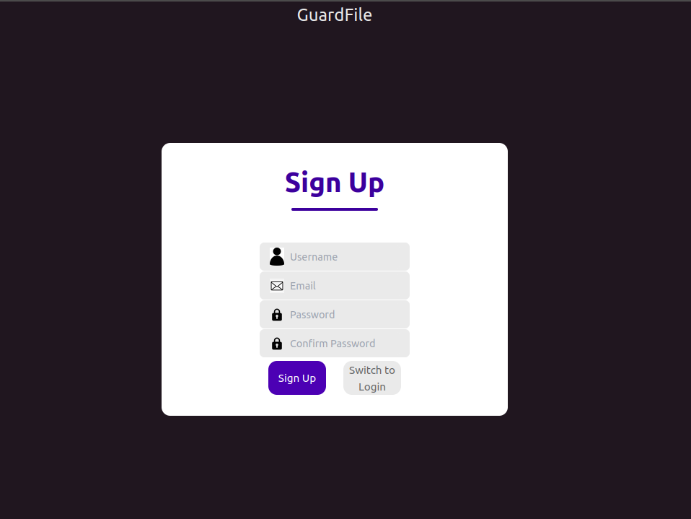
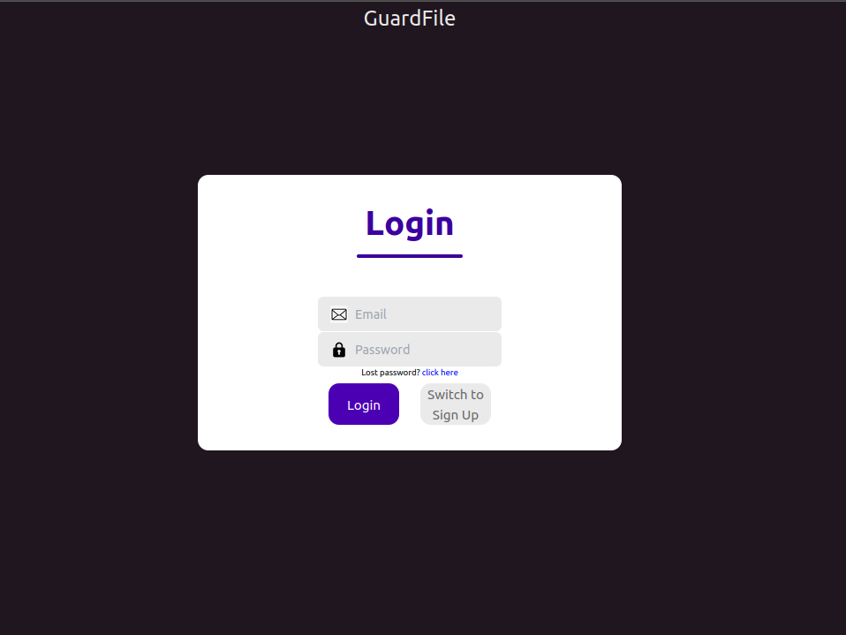
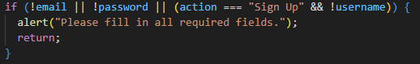
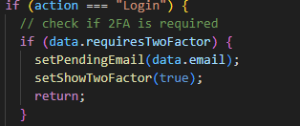
A Quick look at Login/signup
http://localhost:5173/
GuardFile
Progress Report 1

Slide 5
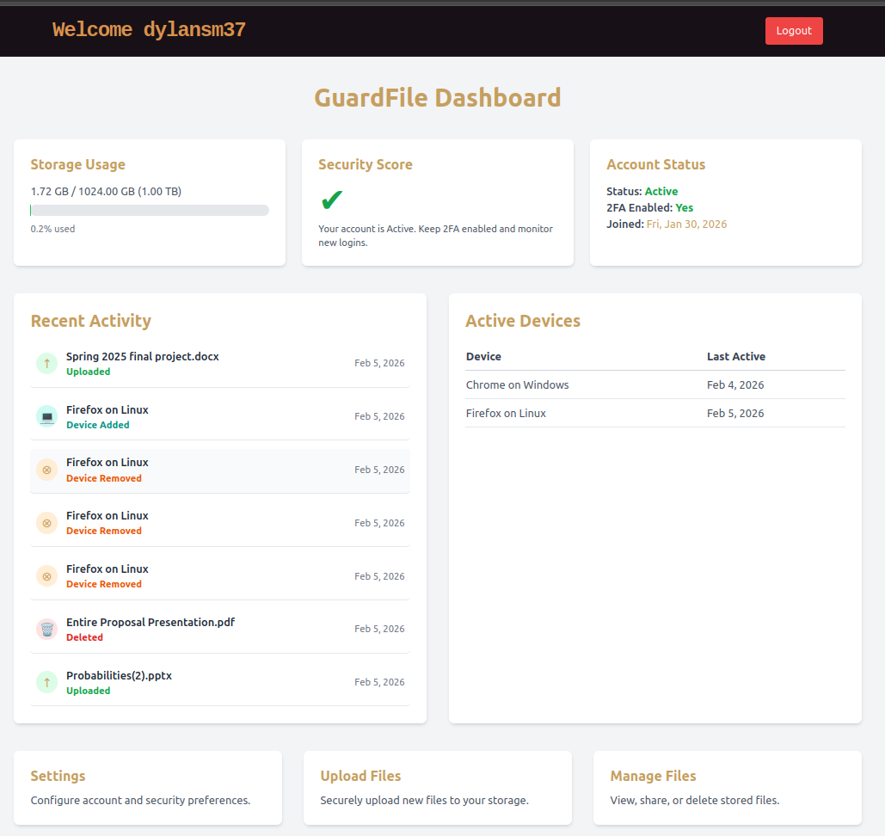
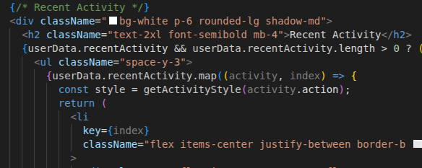
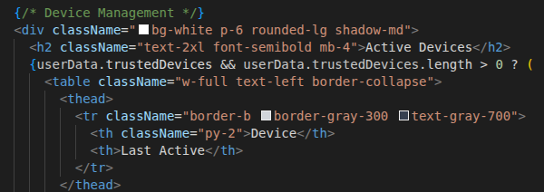
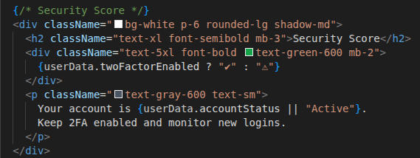
http://localhost:5173/home
HomePage.jsx
Security Score- still in development
GuardFile
Progress Report 1

Slide 6
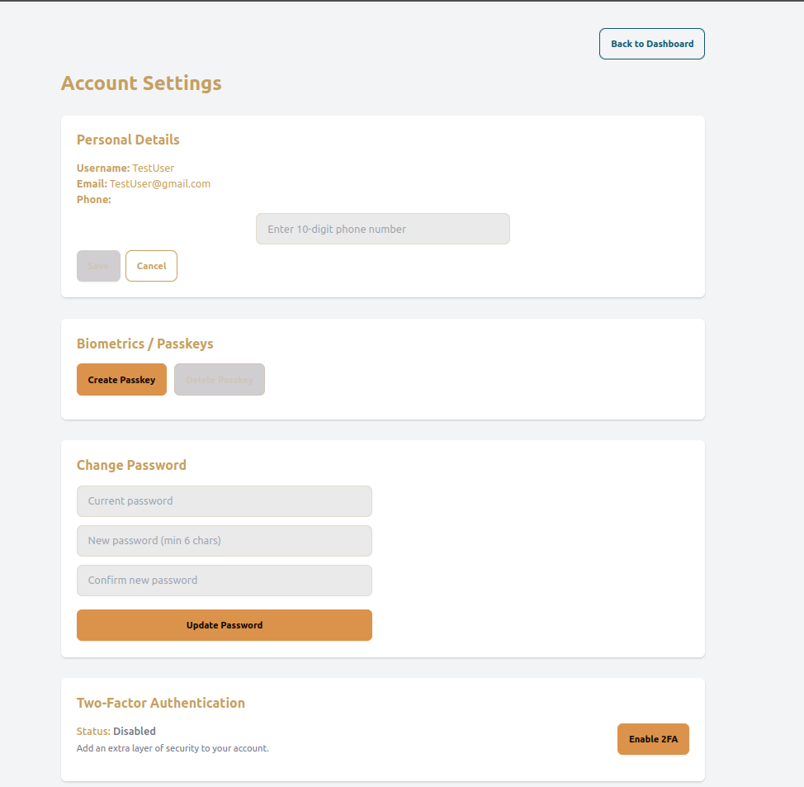
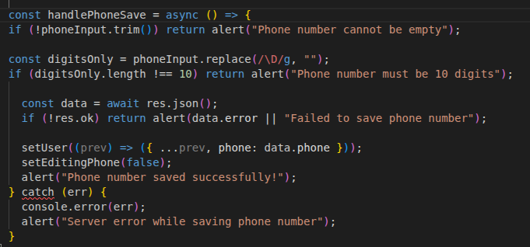
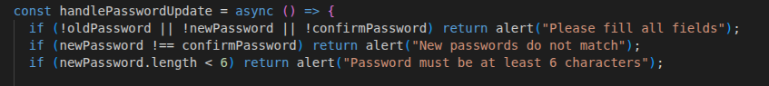
http://localhost:5173/settings
Settings.jsx
GuardFile
Progress Report 1

Slide 7
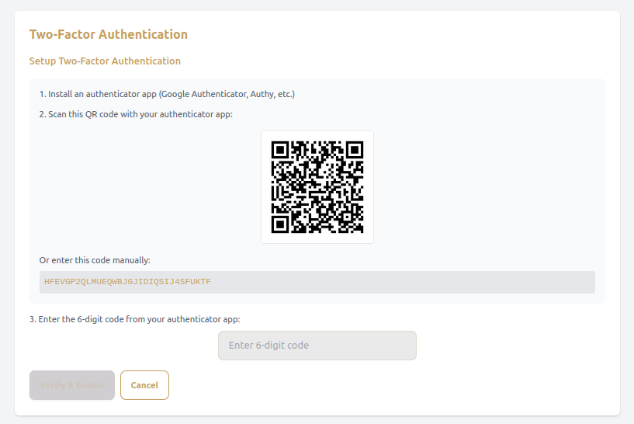
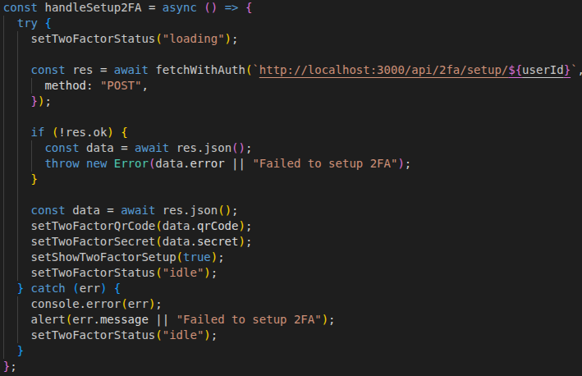
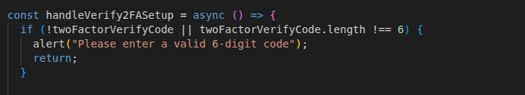
http://localhost:5173/settings
Settings.jsx - 2FA
GuardFile
Progress Report 1

Slide 8
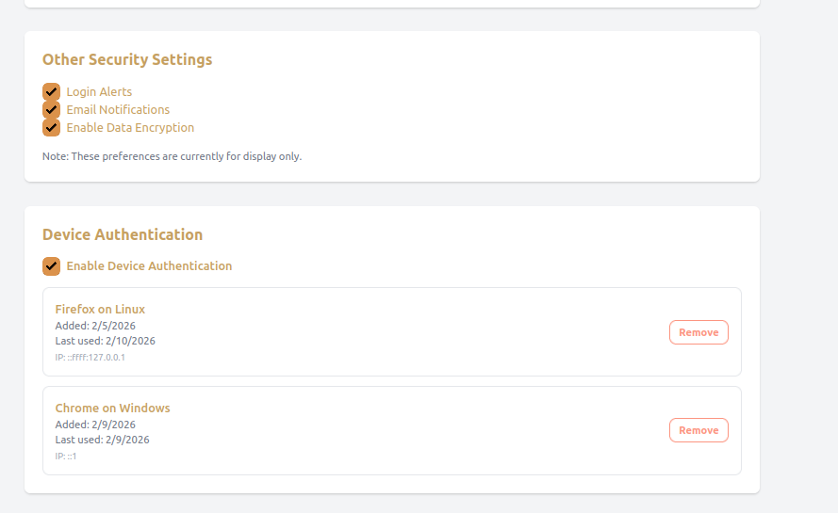
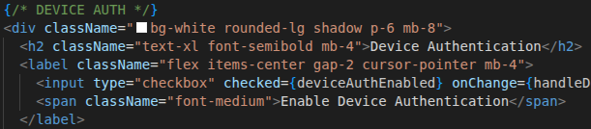
http://localhost:5173/settings
Settings.jsx
GuardFile
Progress Report 1

Slide 9
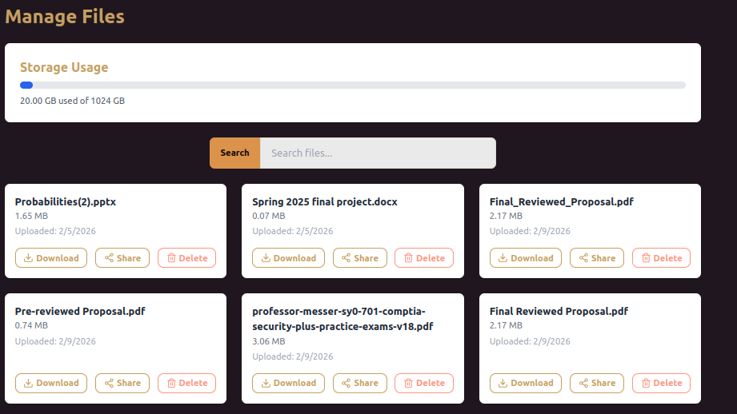
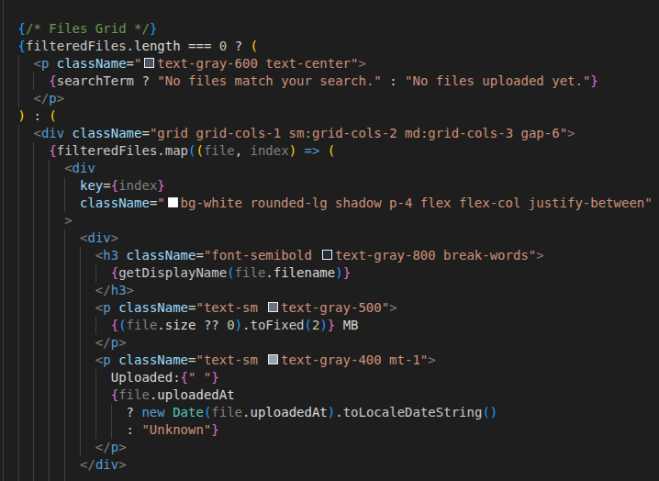
http://localhost:5173/manage
ManageFiles.jsx
GuardFile
Progress Report 1

Slide 10
Thank you
GuardFile
Progress Report 1

